Slide 1





Entity Framework Performance
Svetlin Nakov
Manager Technical Training
http://nakov.com
Telerik Software Academy
http://academy.telerik.com
Entity Framework

Slide 2

Table of Contents
SQL Profilers
The N+1 Query Problem
Incorrect Use of ToList()
Incorrect use of SELECT *
Deleting objects faster with native SQL

Slide 3
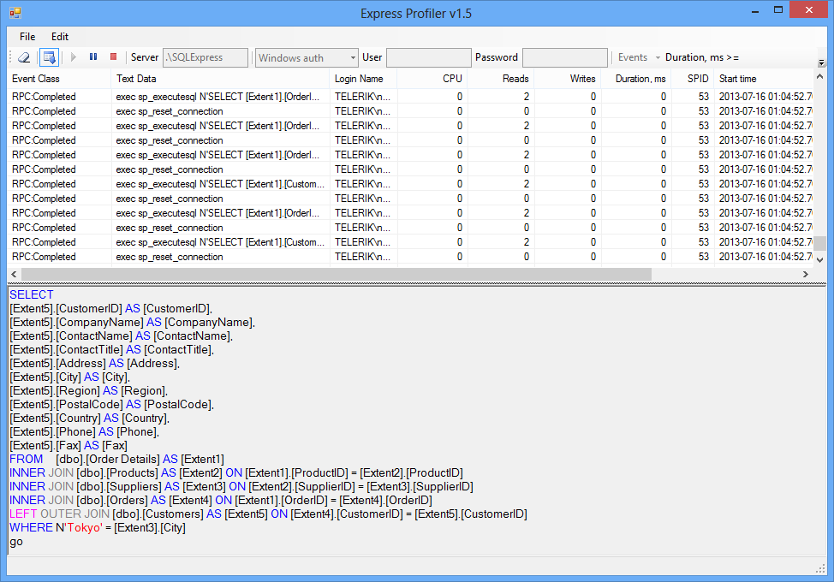
SQL Profilers
How to Trace All Executed SQL Commands?

Slide 4
What is SQL Profiler?
SQL Profilers intercept the SQL queries executed at the server side
Powerful tools to diagnose the hidden Entity Framework queries
SQL Server has "SQL Server Profiler" tool
Part of Enterprise / Developer edition (paid tool)
A free SQL Profiler exists for SQL Server:
Express Profiler: http://expressprofiler.codeplex.com
Easy-to-use, open-source, lightweight, powerful, … and works!

Slide 5
Express Profiler
Live Demo

Slide 6

The N+1 Query Problem
What is the N+1 Query Problem and How to Avoid It?

Slide 7
The N+1 Query Problem
What is the N+1 Query Problem?
Imagine a database that contains tables Products, Suppliers and Categories
Each product has a supplier and a category
We want to print each Product along with its Supplier and Category:
foreach (var product in context.Products)
{
Console.WriteLine("Product: {0}; {1}; {2}",
product.ProductName, product.Supplier.CompanyName,
product.Category.CategoryName);
}

Slide 8
The N+1 Query Problem (2)
This code will execute N+1 SQL queries:
One query to retrive the products
foreach (var product in context.Products)
{
Console.WriteLine("Product: {0}; {1}; {2}",
product.ProductName, product.Supplier.CompanyName,
product.Category.CategoryName);
}
Additional N queries to retrieve the supplier for each product
Additional N queries to retrieve the category for each product
Imagine we have 100 products in the database
That's ~ 201 SQL queries → very slow!
We could do the same with a single SQL query

Slide 9
Solution to the N+1 Query Problem
Fortunately there is an easy way in EF to avoid the N+1 query problem:
Using Include(…) method only one SQL query with join is made to get the related entities
foreach (var product in context.Products.
Include("Supplier").Include("Category"))
{
Console.WriteLine("Product: {0}; {1}; {2}",
product.ProductName, product.Supplier.CompanyName,
product.Category.CategoryName);
}
No additional SQL queries are made here for the related entities

Slide 10

Solution to the N+1 Query Problem
Live Demo

Slide 11

Incorrect Use of ToList()
How ToList() Can Significantly Affect the Performance

Slide 12
Incorrect Use of ToList()
In EF invoking ToList() executes the underlying SQL query in the database
Transforms IQueryable<T> to List<T>
Invoke ToList() as late as possible, after all filtering, joins and groupings
Avoid such code:
This will cause all order details to come from the database and to be filtered later in the memory
List<Order_Detail> orderItemsFromTokyo =
northwindEntities.Order_Details.ToList().
Where(od => od.Product.Supplier.City == "Tokyo").ToList();

Slide 13
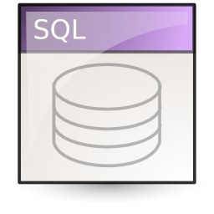
Incorrect Use of ToList()
Live Demo

Slide 14
Incorrect Use of SELECT *
Live Demo

Slide 15
Deleting Entities Faster with Native SQL Query

Slide 16
Deleting Entities
Deleting entities (slower):
Executes SELECT + DELETE commands
Deleting entities with native SQL (faster):
Executes a single DELETE command
NorthwindEntities northwindEntities = new NorthwindEntities();
var category = northwindEntities.Categories.Find(46);
northwindEntities.Categories.Remove(category);
northwindEntities.SaveChanges();
NorthwindEntities northwindEntities = new NorthwindEntities();
northwindEntities.Database.ExecuteSqlCommand(
"DELETE FROM Categories WHERE CategoryID = {0}", 46);

Slide 17
Deleting Entities Faster with Native SQL Query
Live Demo

Slide 18
Entity Framework Performance
http://academy.telerik.com

Slide 19
Homework
Using Entity Framework write a SQL query to select all employees from the Telerik Academy database and later print their name, department and town. Try the both variants: with and without .Include(…). Compare the number of executed SQL statements and the performance.
Using Entity Framework write a query that selects all employees from the Telerik Academy database, then invokes ToList(), then selects their addresses, then invokes ToList(), then selects their towns, then invokes ToList() and finally checks whether the town is "Sofia". Rewrite the same in more optimized way and compare the performance.

Slide 20




Free Trainings @ Telerik Academy
C# Programming @ Telerik Academy
csharpfundamentals.telerik.com
Telerik Software Academy
academy.telerik.com
Telerik Academy @ Facebook
facebook.com/TelerikAcademy
Telerik Software Academy Forums
forums.academy.telerik.com

